Slide 1
Binary Search Tree demonstrating the ability to Insert, Update, and Delete nodes in Java with object-oriented programming
Pawar Shrikant, Ph.D.
https://www.claflin-computation.com/

Slide 2
Properties of Binary Search Tree (BST)
BST is also referred to as ‘Ordered Binary Tree’.
In BST, all the nodes in the left subtree have values that are less than the value of the root node. Similarly, all the nodes of the right subtree of the BST have values that are greater than the value of the root node.
A BST does not allow duplicate nodes.

Slide 3
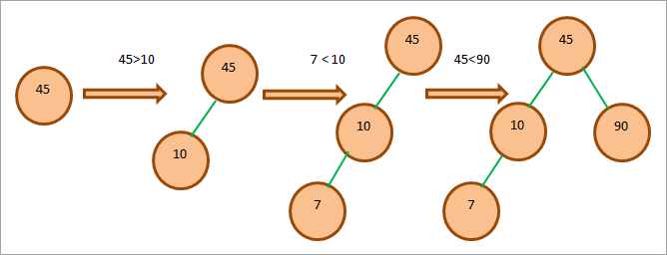
Creating A BST

Slide 4
Binary Search Tree Operations
Method/operation | Description
Insert | Add an element to the BST by not violating the BST properties.
Delete | Remove a given node from the BST. The node can be the root node, non-leaf, or leaf node.
Search | Search the location of the given element in the BST. This operation checks if the tree contains the specified key.

Slide 5
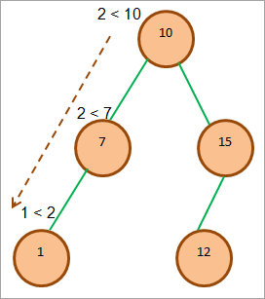
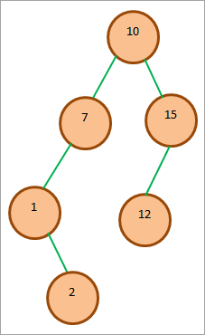
Insert An Element In BST
Start from the root.
Compare the element to be inserted with the root node. If it is less than root, then traverse the left subtree or traverse the right subtree.
Traverse the subtree till the end of the desired subtree. Insert the node in the appropriate subtree as a leaf node.

Slide 6
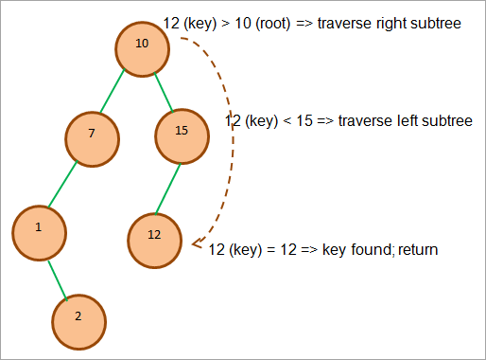
Search Operation In BST
Compare the element to be searched with the root node.
If the key (element to be searched) = root, return root node.
Else if key < root, traverse the left subtree.
Else traverse right subtree.
Repetitively compare subtree elements
until the key is found or the end of the
tree is reached.

Slide 7
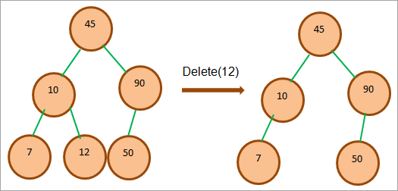
Remove Element From The BST
Node Is A Leaf Node: If a node to be deleted is a leaf node, then we can directly delete this node as it has no child nodes.

Slide 8
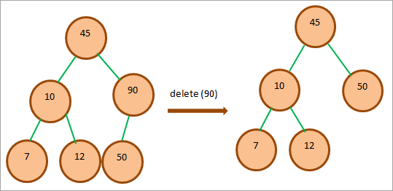
Node Has Only One Child: When we need to delete the node that has one child, then we copy the value of the child in the node and then delete the child.

Slide 9
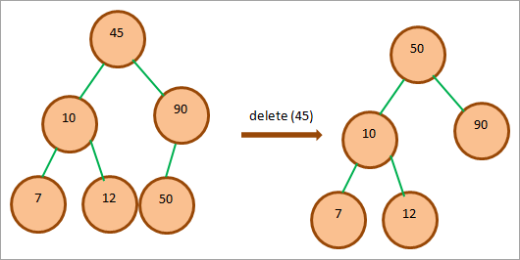
Node Has Two Children: When a node to be deleted has two children, then we replace the node with the minimum node and delete the node.

Slide 10
Create a BST tree in Java and perform 3 functions:
/* BST tree example
45
/ \
10 90
/ \ /
7 12 50 */
//insert above data into BST
The BST after Delete 12(leaf node)
The BST after Delete 90 (node with 1 child)
The BST after Delete 45 (Node with two children)
Search Key 50 in BST
Notes:
class BST_class {
//node class that defines BST node
class Node {
int key;
Node left, right;
public Node(int data){
key = data;
left = right = null;
}
}
// BST root node
Node root;
// Constructor for BST =>initial empty tree
BST_class(){
root = null;
}
//delete a node from BST
void deleteKey(int key) {
root = delete_Recursive(root, key);
}
//recursive delete function
Node delete_Recursive(Node root, int key) {
//tree is empty
if (root == null) return root;
//traverse the tree
if (key < root.key) //traverse left subtree
root.left = delete_Recursive(root.left, key);
else if (key > root.key) //traverse right subtree
root.right = delete_Recursive(root.right, key);
else {
// node contains only one child
if (root.left == null)
return root.right;
else if (root.right == null)
return root.left;
// node has two children;
//get inorder successor (min value in the right subtree)
root.key = minValue(root.right);
// Delete the inorder successor
root.right = delete_Recursive(root.right, root.key);
}
return root;
}
int minValue(Node root) {
//initially minval = root
int minval = root.key;
//find minval
while (root.left != null) {
minval = root.left.key;
root = root.left;
}
return minval;
}
// insert a node in BST
void insert(int key) {
root = insert_Recursive(root, key);
}
//recursive insert function
Node insert_Recursive(Node root, int key) {
//tree is empty
if (root == null) {
root = new Node(key);
return root;
}
//traverse the tree
if (key < root.key) //insert in the left subtree
root.left = insert_Recursive(root.left, key);
else if (key > root.key) //insert in the right subtree
root.right = insert_Recursive(root.right, key);
// return pointer
return root;
}
// method for inorder traversal of BST
void inorder() {
inorder_Recursive(root);
}
// recursively traverse the BST
void inorder_Recursive(Node root) {
if (root != null) {
inorder_Recursive(root.left);
System.out.print(root.key + " ");
inorder_Recursive(root.right);
}
}
boolean search(int key) {
root = search_Recursive(root, key);
if (root!= null)
return true;
else
return false;
}
//recursive insert function
Node search_Recursive(Node root, int key) {
// Base Cases: root is null or key is present at root
if (root==null || root.key==key)
return root;
// val is greater than root's key
if (root.key > key)
return search_Recursive(root.left, key);
// val is less than root's key
return search_Recursive(root.right, key);
}
}
class Main{
public static void main(String[] args) {
//create a BST object
BST_class bst = new BST_class();
//insert data into BST
bst.insert(45);
bst.insert(10);
bst.insert(7);
bst.insert(12);
bst.insert(90);
bst.insert(50);
//print the BST
System.out.println("The BST Created with input data(Left-root-right):");
bst.inorder();
//delete leaf node
System.out.println("\nThe BST after Delete 12(leaf node):");
bst.deleteKey(12);
bst.inorder();
//delete the node with one child
System.out.println("\nThe BST after Delete 90 (node with 1 child):");
bst.deleteKey(90);
bst.inorder();
//delete node with two children
System.out.println("\nThe BST after Delete 45 (Node with two children):");
bst.deleteKey(45);
bst.inorder();
//search a key in the BST
boolean ret_val = bst.search (50);
System.out.println("\nKey 50 found in BST:" + ret_val );
ret_val = bst.search (12);
System.out.println("\nKey 12 found in BST:" + ret_val );
}
}

